Slide 1

HOW TO REPORT ACCURATELY WITHOUT
GETTING “CANCELED” ALONG THE WAY?
Strategies and data to identify your audience and counter misinformation
Notes:
How to Report Accurately Without Getting Cancelled Along the Way
In a fast-moving digital environment, creating content that is accurate, engaging, and responsible can be challenging—especially when covering sensitive or polarizing topics.
In this hands-on webinar, Factchequeado will share practical strategies for content creators to verify information using both traditional fact-checking methods and AI-powered verification tools, identify misinformation, and report responsibly while maintaining credibility with their audiences.
We’ll also explore what it means to create content as a bilingual Latino creator speaking to the diverse and complex Latino communities in the United States. Using data and research about Latino audiences—including how they consume, share, and engage with information—we’ll discuss how creators can better understand who they are speaking to, avoid treating Latinos as a monolithic audience, and make more informed decisions about the topics, language, framing, and formats they use.
The goal is to give creators practical tools to produce reliable, high-quality content, navigate public backlash and misinformation, and build trust with the communities they serve.

Slide 2
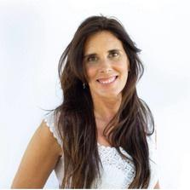
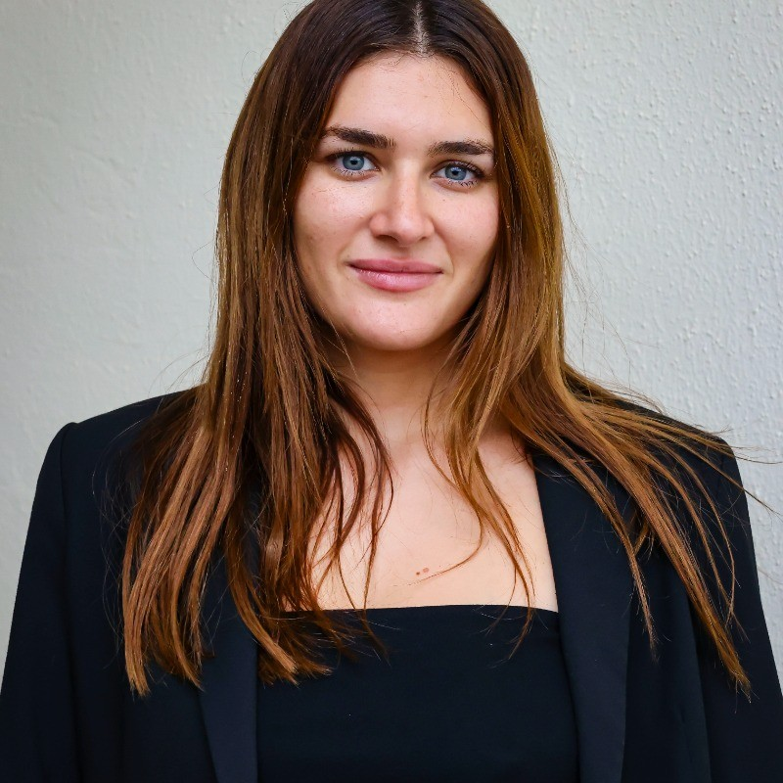
WHO WE ARE
Laura Zommer
Co-founder & CEO Factchequeado
Olivia Rivarola
Social Media Manager
Factchequeado

Slide 3
CONTENT
01
Before recording — Know your audience and identify good information
02
During recording — How to communicate without spreading misinformation
After recording: What to do if you shared false information
03

Slide 4
1. BEFORE RECORDING

Slide 5
ABOUT LATINO AUDIENCES…

Slide 6
WHO ARE LATINOS IN THE U.S.
A large, young, mostly U.S.-born audience with diverse origins.
68 million
31 years old
2 in 3
57%
Latinos live in the U.S.: 1 in 5 people. In 2000, there were 35 million.
is their average age, the youngest in the country. White Americans: 43. Asians: 39. Black Americans: 36.
Latinos were born in the U.S. Immigrants are 1 in 3.
are of Mexican origin. They are followed by Puerto Ricans, Cubans, Salvadorans, Dominicans, Guatemalans, Colombians, Hondurans, Venezuelans, and Ecuadorians.
Source: Pew Research Center, “Key facts about U.S. Latinos” (Oct. 2025), using 2024 U.S. Census data.

Slide 7
WHERE THEY GET THEIR NEWS
Percentage of Latinos who get news at least sometimes through each source:
By platform
Within the internet
Internet
87%
Search engines (Google)
74%
TV
62%
News websites or apps
60%
Radio
48%
Social media
56%
Newspapers or magazines
32%
Podcasts
31%
Source: Pew Research Center, “How Hispanic Americans Get Their News” (Mar. 2024). Survey of U.S. adults, Sept.–Oct. 2023.

Slide 8
SOCIAL MEDIA AND CONTENT CREATORS
30%
of Latinos regularly get news from news creators, the highest share among all groups within the US.
65%
of those who follow news creators say they helped them better understand current events.
77%
of the most popular news creators have never worked for a news organization.
For reference: Latinos are 1 in 5 people in the U.S.
Sources: Pew Research Center, “Social Media and News Fact Sheet” and its demographic appendix (Sept. 2025), “America’s News Influencers” (Nov. 2024), and “Key facts about U.S. Latinos” (Oct. 2025).

Slide 9
WHAT LANGUAGE THEY GET THEIR NEWS IN
Most get their news in English. The biggest difference is between U.S.-born Latinos and immigrants.
Mostly in English
Both equally
Mostly in Spanish
All Latinos
54%
23%
21%
U.S.-born
81%
16%
Immigrants
26%
31%
41%
2 in 3 Latinos can read in Spanish, but only 21% choose to get their news in that language.
Source: Pew Research Center, “How Hispanic Americans Get Their News” (Mar. 2024). National Survey of Latinos, Nov. 2023.

Slide 10
SPANISH AND SPANGLISH
Spanish remains part of Latino identity, although its use declines across generations.
75%
63%
68%
can carry on a conversation in Spanish. Among third-generation immigrants or later, only 34%.
use Spanglish at least sometimes.
speak Spanish at home. In 2000, that figure was 78%.
78%
54%
85%
believe speaking Spanish is not necessary to be Latino.
of Latinos who do not speak Spanish have been criticized by another Latino for it.
believe it is important for future generations to speak Spanish.
Sources: Pew Research Center, “Latinos’ Views of and Experiences With the Spanish Language” (Sept. 2023) and “Key facts about U.S. Latinos” (Oct. 2025).

Slide 11
HOW TO FIND GOOD INFORMATION

Slide 12
FIND GOOD SOURCES OF INFORMATION
Don’t believe everything at first glance
Do a “double click.” Search Google using the topic’s keywords, or run a reverse image search on Google.

Slide 13
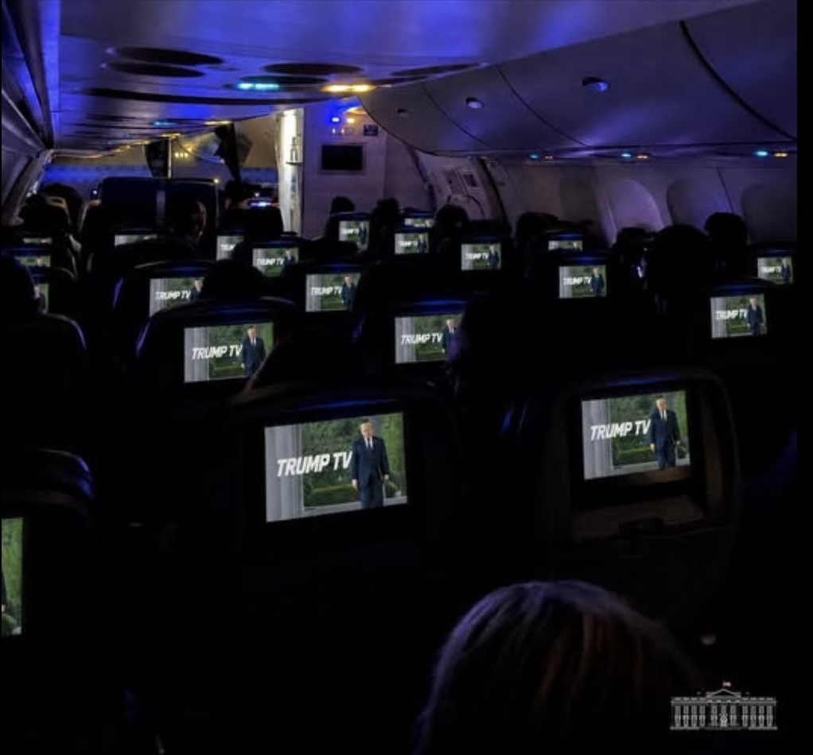
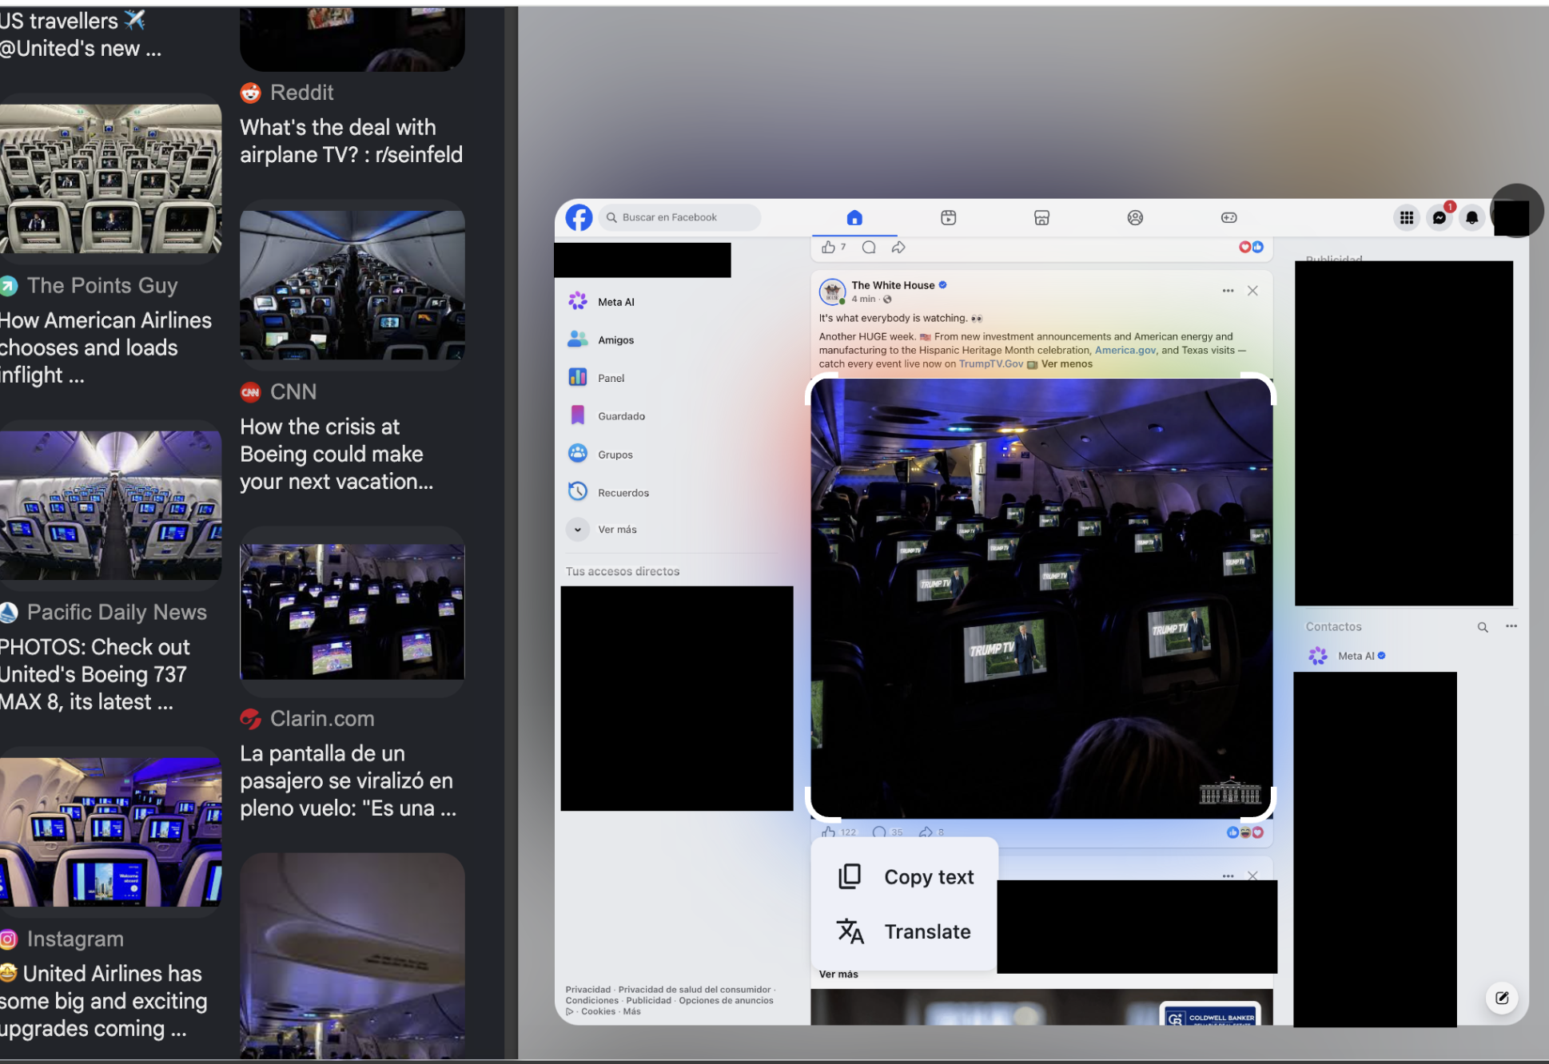
GOOGLE REVERSE IMAGES

Slide 14
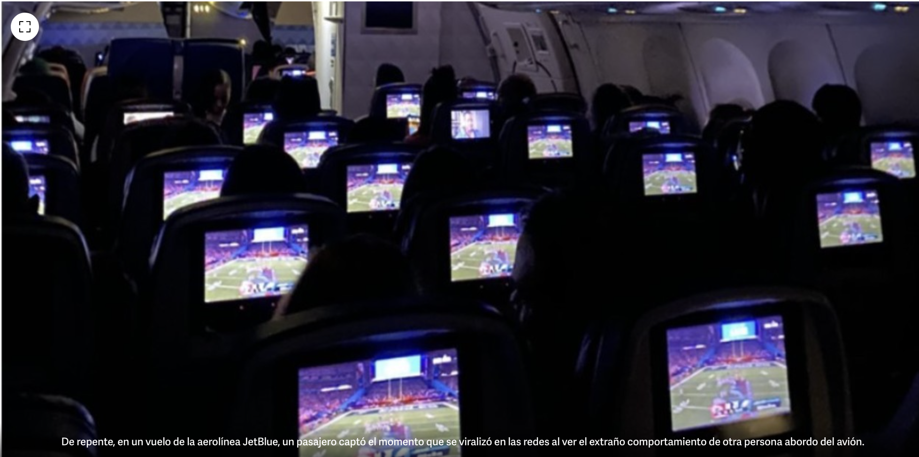
GOOGLE REVERSE IMAGES
February 2023.
Real image: passengers watching the Super Bowl on a plane.

Slide 15
FIND GOOD SOURCES OF INFORMATION
Don’t believe everything at first glance
Do a “double click.” Search Google using the topic’s keywords, or run a reverse image search on Google.
Evaluate the channel where the information was published. Is it from a recognized media outlet, a social network, or a website without clear sources?
Compare different points of view and recognize biases
Identify the sources. Is it a reliable source? Is the person speaking an expert on the topic? If it is a website, does it have an “About us” section? What reputation does it have among experts or journalists?
Recognize your own biases. Sometimes you may like a source only because it confirms what you already think. This is called “confirmation bias.”

Slide 16
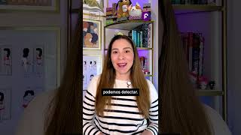
SHARING IMAGES? CHECK IF THEY WERE MADE WITH AI

Slide 17
SHARING IMAGES? CHECK IF THEY WERE MADE WITH AI
  With images, always ask yourself: Who took it? What is the source? Is there a credit for a photographer or agency? It is always good practice to add the photo credit to attribute authorship.
  Look at the details. AI-generated images often have imperfections.
  Use tools such as Hive Moderation, Deepware, Deepmind, and Resemble AI to check whether it was digitally created (but know that these tools are not 100% foolproof).
  If it was created with AI and you still want to share it, make that clear. Be transparent about it. Saying it in the audio or adding the text “image created with AI” or “video generated with AI” is enough.

Slide 18
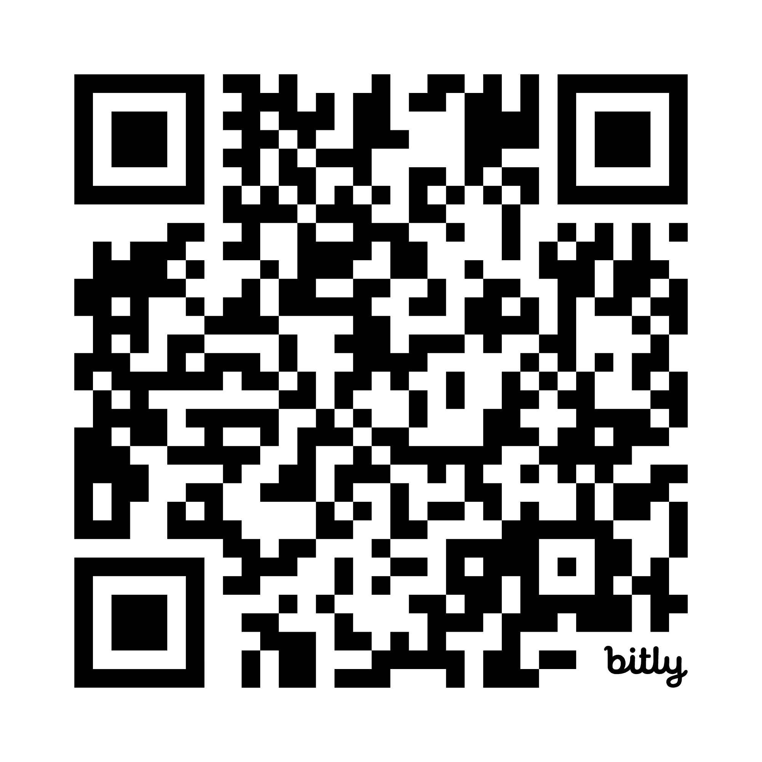
Survey!
https://docs.google.com/forms/d/13qmc-wA5WKXREzeb8kINscy6WzM0sA325qjHHXLiFZM/preview

Slide 19

SHARING VALUABLE INFORMATION? HOW TO VERIFY ITS ACCURACY FIRST
  Strong emotions: if a piece of content makes you laugh, feel afraid, or get angry, it is more likely to be misinformation. When in doubt, and before sharing it, verify it.
  Quick check: search keywords on Google or run a reverse image search to see whether that content has already been published or debunked.
  Information diet: consult diverse media outlets (large, small, local, and independent) to compare information.
  Another resource: if you are unsure, send the content to Factchequeado’s chatbot (+1 646-873-6087). Our team of journalists will verify the content and tell you whether it is true or not.

Slide 20
2. DURING RECORDING

Slide 21
FACT OR OPINION?
Why is it important to distinguish between opinion and fact?
When you record content for your followers, your voice carries weight and can influence how people perceive reality.
That is why it is essential to clarify whether what you are sharing is a verified fact or your opinion. This helps your audience trust you and avoid misinformation.

Slide 22
HOW TO DISTINGUISH AND CLARIFY?
Attribute what you are saying
FACT
OPINION
A verifiable event, action, or statement. Example: “Today is Monday” or “WHO published a report on mental health in 2025.”
A personal interpretation, belief, or judgment. Example: “I think this report is very useful” or “In my experience, Mondays are hard.”
THIRD-PARTY ATTRIBUTION
When, for example, the source is an expert, this is not a fact and not necessarily an opinion; it is based on the findings of their work.

Slide 23
Use clear phrases to differentiate
FACT
OPINION
“According to [source],…” e.g., “According to the most recent DHS statistics”
  “Data from [source] show that…” e.g., “The available ICE data show that…”
  “It has been verified according to [source] that…” “It has been verified according to MedlinePlus…”
  If you verified it directly, explain how you did it (for example, through a Google search or with AI detection tools)
“In my opinion…”
  “From my point of view…”
  “I believe that…”
  If you are not sure, use conditional language: “It could be that…” or “It is possible that…” It is okay to clearly state what is not yet known.

Slide 24
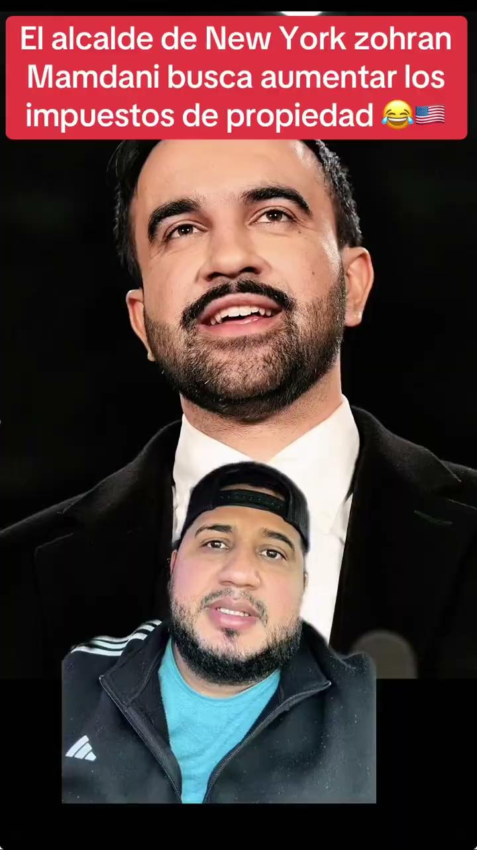

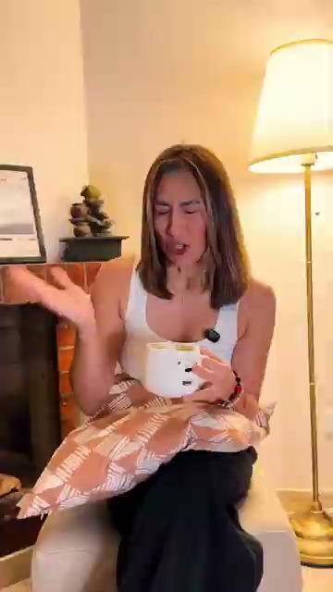
Examples
OPINION
FACT
THIRD-PARTY ATTRIBUTION

Slide 25
ATTRIBUTION
Saying “I saw it on social media” is not proper attribution.
Attribution rules:
  Say who said it. Is it a media outlet? A journalist? Another influencer? An organization? A public agency? Make that clear. It slows speculation down. And, far from weakening your content, it strengthens it.
  If you can, mention where they said it (in a media outlet, in an investigation, at a conference, or at a public event). For example: “@username said it in their TikTok video on May 4, 2025.”
  Do not share direct quotes without saying where they come from (they could be false, and you could be contributing to misinformation or even exposing yourself to legal problems).
  If you do not know the source but still want to share it, make that clear too.

Slide 26
3. AFTER RECORDING

Slide 27
What should you do when you shared false content and realized it too late?
We all make mistakes. Journalists, academics, politicians, and even teachers. And without meaning to, we may spread misinformation without knowing it. The goal is not to never make mistakes, but to know what to do when it happens and to be transparent with our followers and community.

Slide 28
Some tips if this happens to you:
  Delete the content and explain that you removed it because it was false (for example, through a story).
  It is not recommended to simply add a comment to the video or tweet, or edit the caption, because if the video with false content remains visible, you are still spreading it. Not everyone reads the comments or the message in a post.
  It is also not recommended to make another video saying that the previous video is false without deleting the original, because you are still helping it spread.
  It is also not a good idea to point to the origin of the false content. If you can avoid revealing the user who originally shared it, even better.

Slide 29
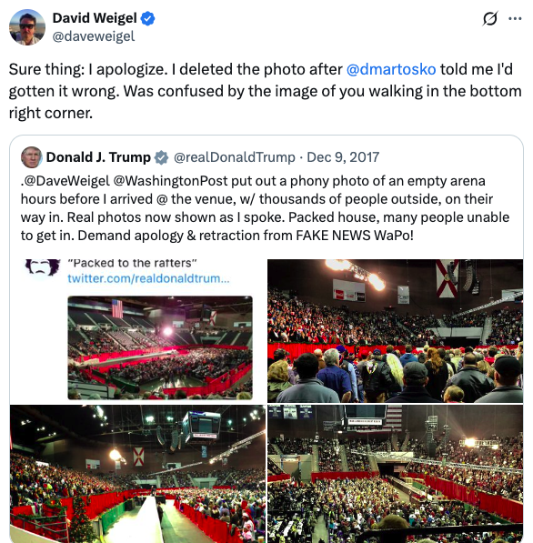
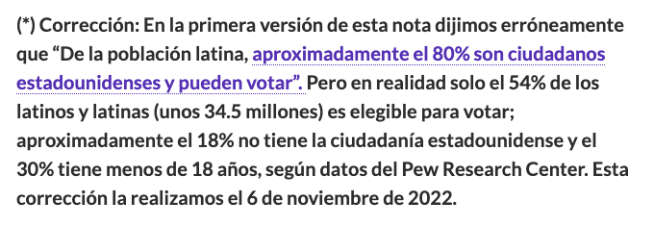
Example of a correction:

Slide 30
COMMUNICATING RESPONSIBLY IS PART OF YOUR SUCCESS
  As a content creator, your voice carries weight and your community believes in you. That is why it is important to communicate responsibly, because your audience is listening.
  You have the right to share your opinion, but also the opportunity to inform responsibly and without misleading people. With these recommendations, you can keep creating authentic content without contributing to the amplification of misinformation.

Slide 31






THANK YOU!
@factchequeado

